Slide 1
JS Popular Design Patterns
Presentation by Nikoleta Terzieva

Slide 2
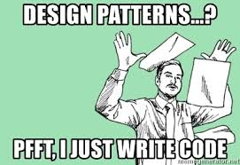
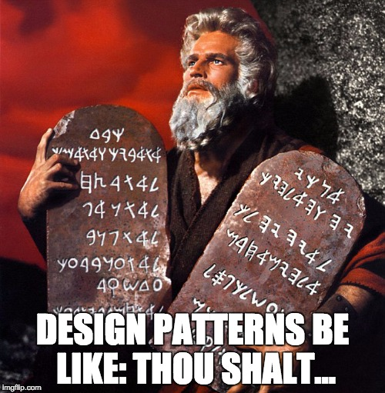
There are 10 types of developers

Slide 3
What are design anti-patterns?
An anti-pattern ineffective and non-productive response to repeating problem.
Is it a bad idea or an anti-pattern?
Process, structure, or actions that have more bad consequences than good ones.
Another solution exists that is documented, repeatable, and proven to be effective.

Slide 4
Anti-patterns
Big ball of mud – system with no structure
Gold plating – digging in a task after certain point
Repeating yourself – repeating code
Copy and paste programming - … :)
Golden hammer – use favorite solution everywhere
God object
Object orgy
Reinventing the square wheel – custom instead of proven solution
Cargo cult programming – using without understanding
...and many more
Notes:
Big ball of mud: A system with no recognizable structure
Gold plating: Continuing to work on a task or project well past the point at which extra effort is not adding value
God object: Concentrating too many functions in a single part of the design (class)
Object orgy: Failing to properly encapsulate objects permitting unrestricted access to their internals
Cargo cult programming: Using patterns and methods without understanding why
Repeating yourself: Writing code which contains repetitive patterns and substrings over again; avoid with once and only once (abstraction principle)
Copy and paste programming: Copying (and modifying) existing code rather than creating generic solutions
Golden hammer: Assuming that a favorite solution is universally applicable
Reinventing the square wheel: Failing to adopt an existing solution and instead adopting a custom solution which performs much worse than the existing one
Dll hell & JAR hell - what about node_modules hell :) ?

Slide 5
What are design patterns?
Design patterns are typical solutions to common problems
Reusable
Easer to describe and use among developers
Prevent or minimize the need of refactoring
Help for smaller code base

Slide 6
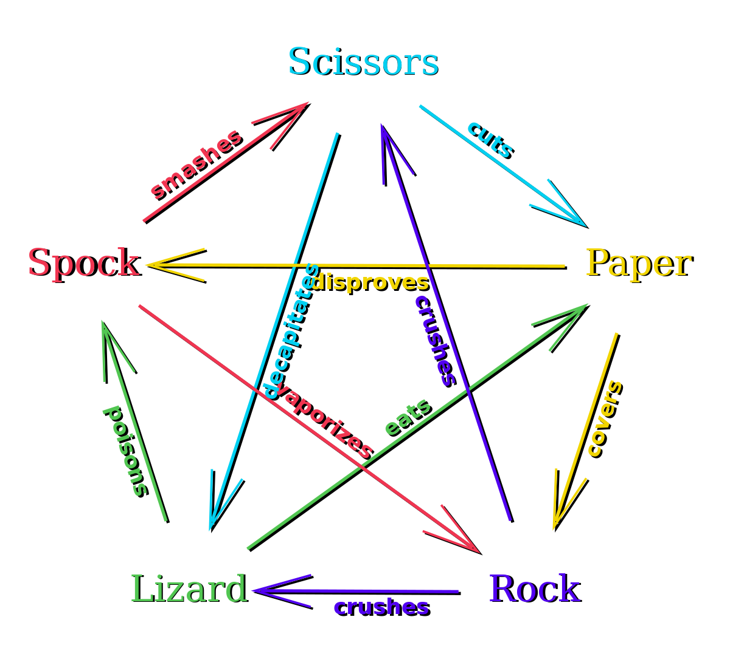
Choosing the right design pattern feels like

Slide 7
Design patterns in the past
In 1994 The Gang of Four described the capabilities of DP by presenting 23 good practices.
3 major groups of DP ( design patterns ):
Creational
Structural
Behavioral
Architectural

Slide 8

Creational Design Patterns
Provide various object creation mechanisms, which increase flexibility and reuse of existing code
Abstract Factory
Builder
Factory Method
Prototype
Singleton
Notes:
Abstract factory pattern groups object factories that have a common theme.
Builder pattern constructs complex objects by separating construction and representation.
Factory method pattern creates objects without specifying the exact class to create.
Prototype pattern creates objects by cloning an existing object.
Singleton pattern restricts object creation for a class to only one instance.

Slide 9
Structural Design Patterns
Explain how to assemble objects and classes into larger structures, while keeping this structures flexible and efficient
Adapter
Bridge
Composite
Decorator
Façade
Flyweight
Proxy
Notes:
Adapter allows classes with incompatible interfaces to work together by wrapping its own interface around that of an already existing class.
Bridge decouples an abstraction from its implementation so that the two can vary independently.
Composite composes zero-or-more similar objects so that they can be manipulated as one object.
Decorator dynamically adds/overrides behaviour in an existing method of an object.
Facade provides a simplified interface to a large body of code.
Flyweight reduces the cost of creating and manipulating a large number of similar objects.
Proxy provides a placeholder for another object to control access, reduce cost, and reduce complexity

Slide 10
Behavioral Design Patterns
Concerned with algorithms and the assignment of responsibilities between objects
Chain of responsibility
Command
Interpreter
Mediator
Memento
Observer
State
Strategy
Template method
Visitor
Notes:
Chain of responsibility delegates commands to a chain of processing objects.
Command creates objects which encapsulate actions and parameters.
Interpreter implements a specialized language.
Iterator accesses the elements of an object sequentially without exposing its underlying representation.
Mediator allows loose coupling between classes by being the only class that has detailed knowledge of their methods.
Memento provides the ability to restore an object to its previous state (undo).
Observer is a publish/subscribe pattern which allows a number of observer objects to see an event.
State allows an object to alter its behavior when its internal state changes.
Strategy allows one of a family of algorithms to be selected on-the-fly at runtime.
Template method defines the skeleton of an algorithm as an abstract class, allowing its subclasses to provide concrete behavior.
Visitor separates an algorithm from an object structure by moving the hierarchy of methods into one object.

Slide 11
Architectural Design Patterns
Similar to design patterns but have a broader scope
Client-server
Layered
Master-slave
Peer-to-peer
MVC
MVP
MVVM
...

Slide 12
How to understand patterns?
With simple examples
By associations to something familiar
Start using them

Slide 13

Module Pattern
One of the most popular JS design pattern
Introduces scopes
Hides variables and functions from the outside world
Exposes only desired functionality
Prevent conflicts related to naming variables and functions
Usage: Everywhere where we want to gain advantage of the scopes

Slide 14
Command Pattern
An abstraction layer between the object that implements a method and the object that wishes to invoke that method.
Decouple objects invoking the action from the objects that implement them
Calls a method by passing some string that specifies unambiguously the method to be invoked. Parameters may be passed also as string or as an object
Usage: When making a CLI( Command language interpreter ), in the UI or some logic where you just want to invoke an action by specifying its name and pass a list of parameters

Slide 15
Adapter pattern
Work through a separate object that adapts to an incompatible interface
Also known as a Wrapper Pattern
Designed to provide a way to use a known interface to access an unknown one.
Usage: When new components need to be integrated and work together with existing components in the application. Refactoring of code where both new code and old one need to be supported

Slide 16
Decorator and High Order Component(HOC)
Allows behavior to be added to an individual object, statically or dynamically, without affecting the behavior of other parts of the system
Used when we can't use inheritance to expand object capabilities
Decorators are an expression that will be evaluated and return a function
HOC wraps an object attaching additional functionality to it
We may use both the HOC and underlying object separately
Once an object is decorated we can't undecorate it
Usage: HOCs are very popular in React, Decorators are widely used in Angular

Slide 17
Observer and Publish/Subscribe
Loosely coupled communication between parts of the application.
Fire and forget communication
Unidirectional data flow
Observer pattern – the observers that want to be notified for a change subscribe directly to the object firing the event
Publish/Subscribe - there is a middle layer (event/topic channel) sitting between the objects receiving the notifications and the object firing the event/topic
Usage: When we want to get advantage of the push communication and we don't care how the information will be handled by the listeners. Used in Redux and where we want to have unidirectional data flow

Slide 18
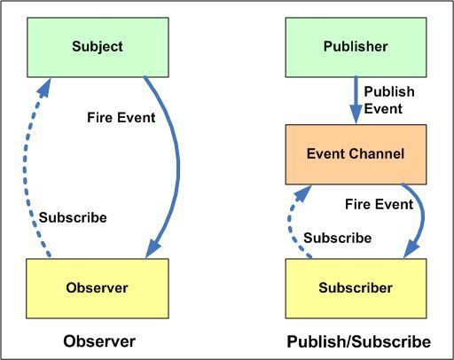

Slide 19
Chain of responsibility and Promise chain
Avoid coupling the sender of a request to its receiver by giving more than one object a chance to handle the request.
Makes a chain of handlers and pass the request along the chain until it's been handled.
Need to efficiently process the requests without creating direct relation between the request object and the handlers
Usage: When we want to process something in a chain manner.

Slide 20
Redux and its patterns
Decorators and HOC – to connect "state" and "dispatch" to component props
Singleton - the state is singleton
Observable pattern + Command pattern - dispatching events from components to the store (unidirectional data flow)
Builder pattern - to build the initial store
Composition of middlewares and chain of responsibility

Slide 21
Conclusion
Design patterns are useful but don't over use them

Slide 22
It's time to discuss

